Slide 1
Algorithm and Explanation for code

Slide 2
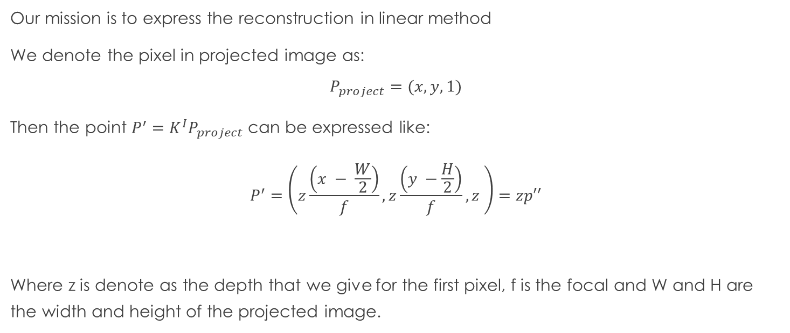
Algorithm
Our mission is to express the reconstruction in linear method
We denote the pixel in projected image as:
$$P_{project}=(x, y, 1)$$
Then the point $P^{′}=K^{I}P_{project}$ can be expressed like:
$$P^{′}=\left(z\frac{\left(x − \frac{W}{2}\right)}{f}, z\frac{\left(y −\frac{H}{2}\right)}{f}, z \right)=zp′′$$
Where z is denote as the depth that we give for the first pixel, f is the focal and W and H are the width and height of the projected image.

Slide 3
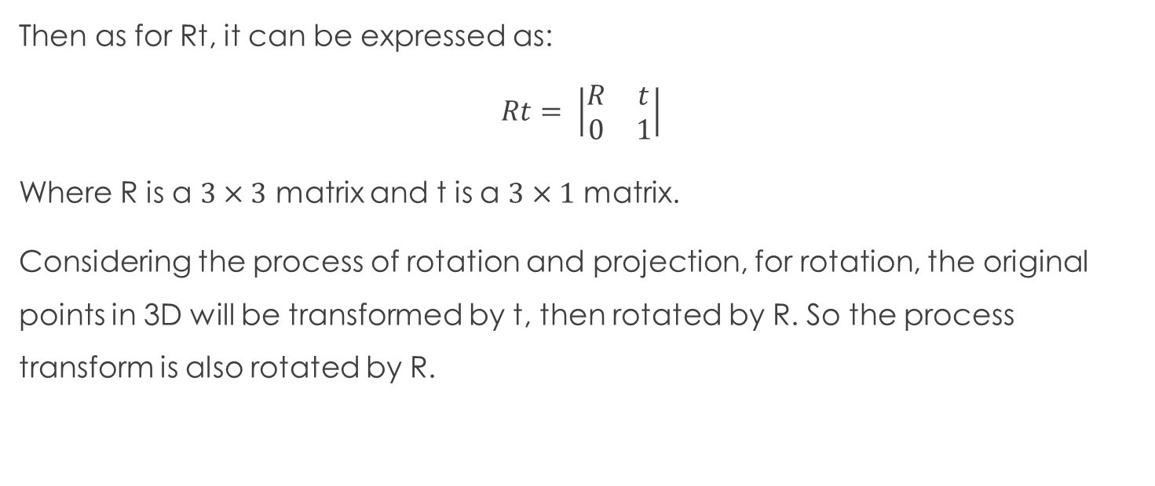
Algorithm
Then as for Rt, it can be expressed as:
$$Rt= \left|\begin{matrix}R & t \\ 0 & 1\end{matrix}\right|$$
Where R is a $3×3$ matrix and t is a $3×1$ matrix.
Considering the process of rotation and projection, for rotation, the original points in 3D will be transformed by t, then rotated by R. So the process transform is also rotated by R.

Slide 4
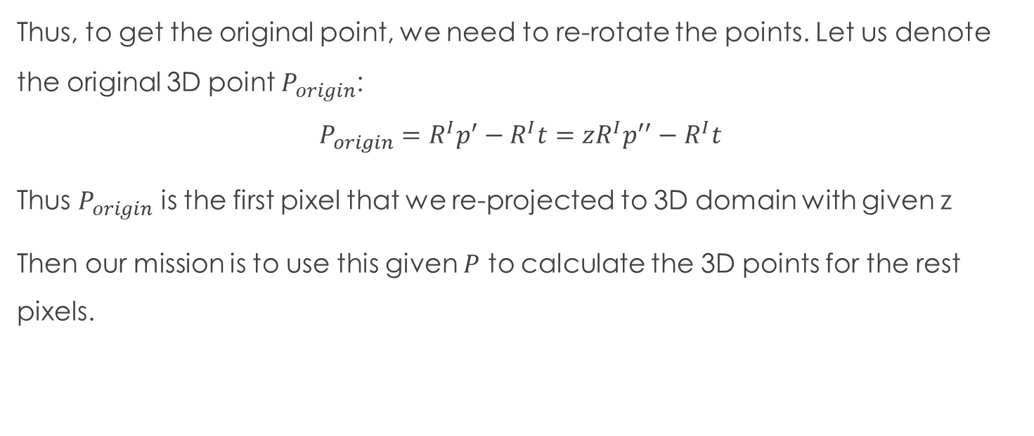
Algorithm
Thus, to get the original point, we need to re-rotate the points. Let us denote the original 3D point $P_{origin}$:
$$P_{origin}=R^{I}p^{′}−R^{I}t=zR^{I}p^{′′}−R^{I}t$$
Thus $P_{origin}$ is the first pixel that we re-projected to 3D domain with given z
Then our mission is to use this given $P$ to calculate the 3D points for the rest pixels.

Slide 5
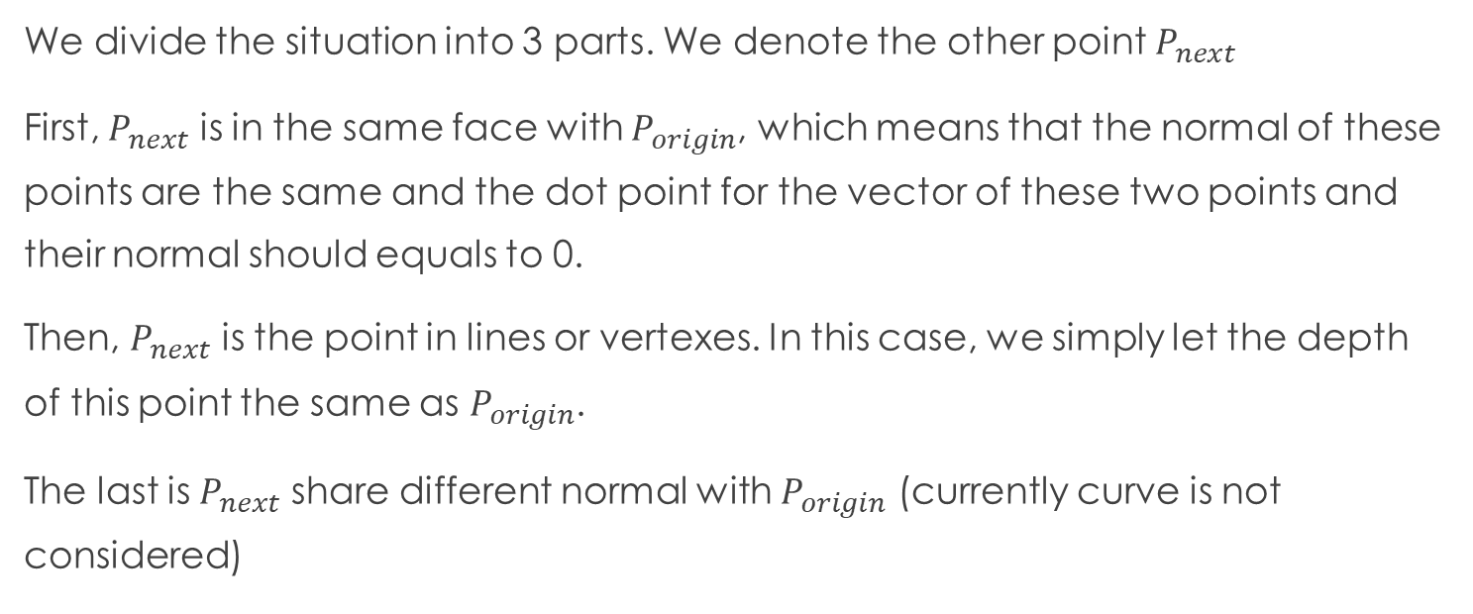
Algorithm
We divide the situation into 3 parts. We denote the other point $P_{next}$
First, $P_{next}$ is in the same face with $P_{origin}$, which means that the normal of these points are the same and the dot point for the vector of these two points and their normal should equals to 0.
Then, $P_{next}$ is the point in lines or vertexes. In this case, we simply let the depth of this point the same as $P_{origin}$.
The last is $P_{next}$ share different normal with $P_{origin}$ (currently curve is not considered)

Slide 6
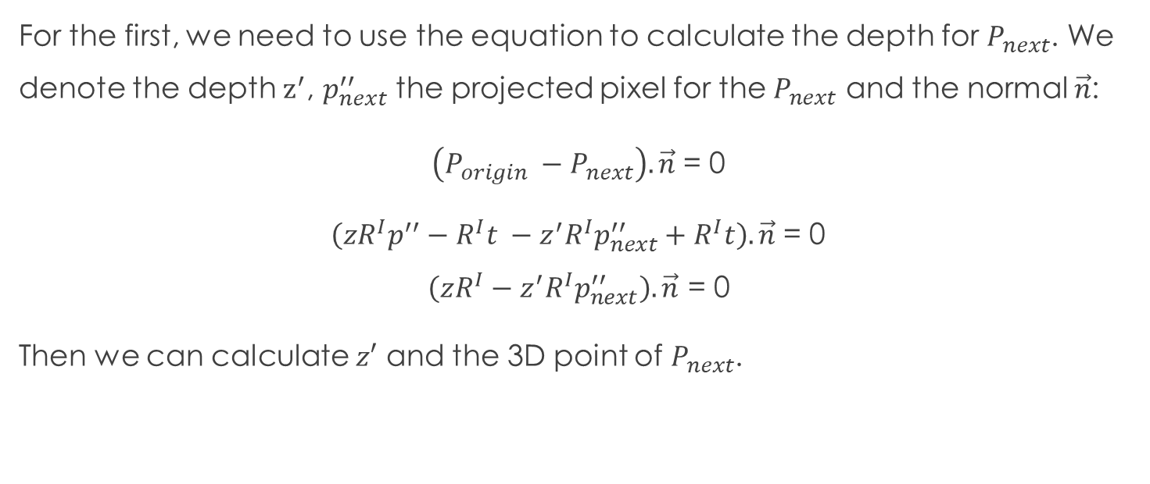
Algorithm
For the first, we need to use the equation to calculate the depth for $P_{next}$. We denote the depth $z^{′}$, $p_{next}^{′′}$ the projected pixel for the $P_{next}$ and the normal $\vec{n}$:
$\left(P_{origin} −P_{next}\right). \vec{n}$ = 0
$\left(zR^{I}p^{′′}−R^{I}t −z^{′}R^{I}p_{next}^{′′}+R^{I}t\right).\vec{n}$ = 0
$$\left(zR^{I}−z^{′}R^{I}p_{next}^{′′}\right).\vec{n}\text{ = 0}$$
Then we can calculate $z′$ and the 3D point of $P_{next}$.

Slide 7
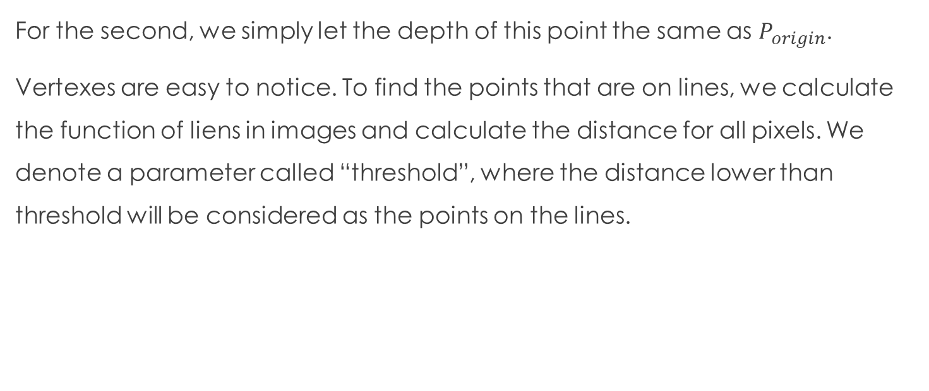
Algorithm
For the second, we simply let the depth of this point the same as $P_{origin}$.
Vertexes are easy to notice. To find the points that are on lines, we calculate the function of liens in images and calculate the distance for all pixels. We denote a parameter called “threshold”, where the distance lower than threshold will be considered as the points on the lines.

Slide 8
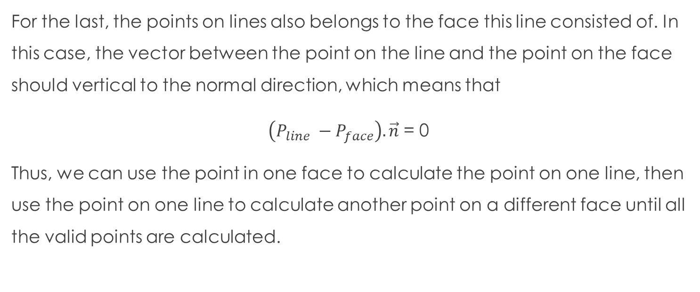
Algorithm
For the last, the points on lines also belongs to the face this line consisted of. In this case, the vector between the point on the line and the point on the face should vertical to the normal direction, which means that
$\left(P_{line} −P_{face}\right). \vec{n}$ = 0
Thus, we can use the point in one face to calculate the point on one line, then use the point on one line to calculate another point on a different face until all the valid points are calculated.

Slide 9
Organization of code
We organize the code in the following sequence:
Input data
Cluster the pixels on faces
Cluster the pixels on lines
Reconstruction setting and initializing the first point
Reconstructing the points from face to line, face to face and line to face.
(We will calculate out all the pixels in one face before calculating another face, which higher the accuracy of reconstruction)

Slide 10
Explanation on parameters
Fc: face cluster, saving which face this pixel belongs to.
Lc: line cluster, saving which line this pixel belongs to.
Points_set: set for saving the reconstructed 3D points
Points_mask: mask for checking whether the point has been calculated
Normal_mask: mask for checking whether the point in one face has been calculated out
X_pro, y_pro: the pixel for the first point.

Slide 11
Explanation on parameters
Cur_nor: save the start point for a new face. Once the calculation expend the points to another face, the function “reconstruction” will return back the pixel of that face and the normal of that face.
Queue: points waiting for calculation. All the points are the neighbors of the previous calculated point.

